Slide 1



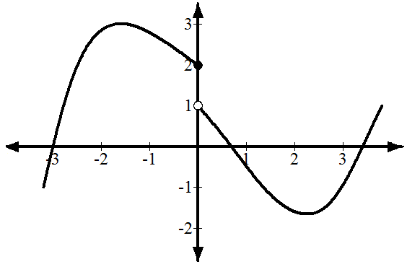
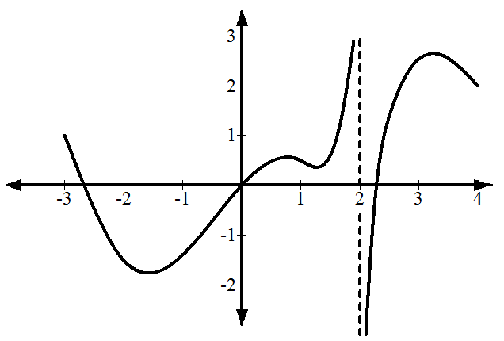
University of Diyala / College of Eng. Civil Engineering Department.
Class: 1st year / Mathematics I
Suppose that a function f has the graph shown on the right. Notice that 𝑓(0) = 2 . (Function value at 0) If 𝑥 ≈ 0 𝑎𝑛𝑑 𝑥 < 0, 𝑡𝑕𝑒𝑛 𝑓(𝑥) ≈ 2.
But if 𝑥 ≈ 0 and x > 0, then 𝑓(𝑥) ≈ 1Therefore, the limit of f(x) as x approaches 0 does not exist.
lim 𝑓 𝑥 exists if and only if
x→a
lim 𝑓(𝑥) and lim 𝑓(𝑥) both exist and are equal.
x→a⁻ x→a⁺
Suppose that a function 𝑓 has the graph shown on the right. Here the interesting behavior of 𝑓 is in vicinity of 𝑥=2.
Notes that 𝑓(2) is undefined an line 𝑥 = 2
is a vertical asymptote.
If 𝑥 ≈ 2 and 𝑥 < 2 then 𝑓(𝑥) is large and positive.
But if 𝑥 ≈ 2 and 𝑥 > 2 then 𝑓(𝑥) is large and negative.
Therefore, the limit of 𝑓(𝑥) as x approaches 2 does not exist. In fact, neither of the one-sided limits exists. However, we can describe the nature of the vertical asymptote by writing
lim f(x) = +∞ and lim f(x) = −∞
𝑥→2⁻ 𝑥→2⁺

Slide 2
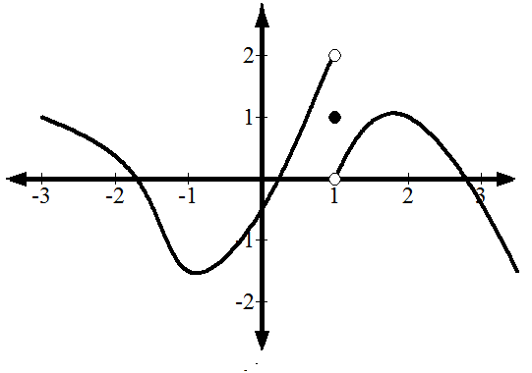
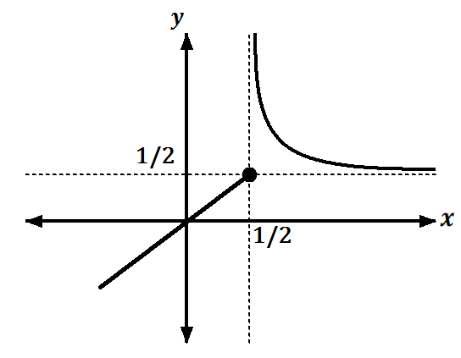
University of Diyala / College of Eng. Civil Engineering Department.
Class: 1st year / Mathematics I
Example1: Given the function 𝑓 whose graph is below, determine the following:
a 𝑓 1 b lim f(x)
x→1⁻
Solution:
a 𝑓 1 = 1
c lim f(x) d
lim f(x)
x→1⁺
x→1
b lim f(x) = 2
x→1⁻
c lim 𝑓(𝑥) = 0
x→1⁺
d lim 𝑓(𝑥) does not exist
x→1
Example2: Given the function 𝑓 whose graph is below, determine the following:
a 𝑙𝑖𝑚₊ 𝑓 𝑥 b 𝑙𝑖𝑚₋ 𝑓 𝑥 c 𝑙𝑖𝑚 𝑓 𝑥 d
𝑙𝑖𝑚 𝑓(𝑥) e 𝑙𝑖𝑚 𝑓(𝑥)
𝑥→+∞ 𝑥→−∞
1
1 1
𝑥→₂
𝑥→₂
𝑥→₂
Solution
a lim 𝑓(𝑥) = +∞
𝑥→1/2⁺
b lim 𝑓(𝑥) = ¹
𝑥→1/2⁻
2
c lim 𝑓(𝑥) = does not exist
𝑥→1/2
1
2
d lim 𝑓(𝑥) =
𝑥→+∞
e lim 𝑓(𝑥) = −∞
𝑥→−∞
Example 3: Show that lim 𝑥 = 0 exist
x→0
Solution/ lim₊ 𝑥 = lim₊ x = 0 for x > 0
x→0 x→0
lim 𝑥 = lim −x = 0 for x < 0
x→0⁻ x→0⁻
∴ lim 𝑥 = 0
x→0
This function is exist

Slide 3

University of Diyala / College of Eng. Civil Engineering Department.
Class: 1st year / Mathematics I
Example 4: f(x)= ^{𝑥 − 4}
if 𝑥 > 4
if 𝑥 < 4
Determine where there Lim exist
8 − 2𝑥
𝑓 𝑥 = 𝑥 − 4 for x > 4 right side
x→4
Solution :
lim f x = lim 𝑥 − 4 = 4 − 4 = 𝟎
x→4⁺ x→4⁺
f x = 8 − 2𝑥 for x < 4 left side
lim f x = lim 8 − 2𝑥 = 4 − 4 = 𝟎
x→4⁻
x→4⁻
𝑥 − 2
Example 5: if 𝑓 𝑥 =
, determine the following: −
𝑥² + 𝑥 − 6
a 𝑙𝑖𝑚 𝑓 𝑥 b
𝑙𝑖𝑚 𝑓 𝑥 c 𝑙𝑖𝑚 𝑓 𝑥
𝑥→2⁻ 𝑥→2
𝑥→2⁺
a lim 𝑓 𝑥 = lim
𝑥 − 2 𝑥 − 2
1 ₌ 1
= lim = lim
𝑥→2⁺
𝑥→2⁺ 𝑥² + 𝑥 − 6 𝑥→2⁺ 𝑥 + 3 𝑥 − 2 𝑥→2⁺ 𝑥 + 3 5
b lim 𝑓 𝑥 = lim
− 𝑥 − 2 − 𝑥 − 2
−1
= lim = lim = − ¹
𝑥→2⁻
𝑥→2⁻ 𝑥² + 𝑥 − 6 𝑥→2⁻ 𝑥 + 3 𝑥 − 2 𝑥→2⁻ 𝑥 + 3 5
c lim 𝑓(𝑥) = does not exist
𝑥→2
Continuity of a graph is loosely defined as the ability to draw a graph without having to lift your pencil.
If 𝑓(𝑥) is defined on an open interval containing c, then 𝑓(𝑥) is said to be continuous at c if and only if the limit as x approaches c equals 𝑓(𝑥)
lim 𝑓(𝑥) = 𝑓(𝑐)
x→c
⟣ Can we say the function f is continuous at a number c if:-
① 𝑓(c) is defined (c is in the domain of 𝑓)
② lim 𝑓 𝑥 exist
x→c
③ lim 𝑓(𝑥) = 𝑓(𝑐)
x→c

Slide 4
University of Diyala / College of Eng. Civil Engineering Department.
Class: 1st year / Mathematics I
Example1: given 𝑓 𝑥 = ^{𝑥2 + 3 𝑥 ≤ 2} is the function continuous at 𝑥 = 2?
3𝑥 + 2 𝑥 > 2
Solution:
① At 𝑥 = 2 𝑓(𝑥) =𝑥² + 3 𝑓 (2)= 2 ² + 3 = 7
② lim 𝑓 𝑥 = lim 𝑥² + 3 = 7
x→2⁻ x→2⁻
lim 𝑓 𝑥 = lim 3𝑥 + 2 = 6
x→2⁺ x→2⁺
Therefore the function is not continuous at 𝑥 = 2
Example2: 𝑓 𝑥 =
Solution:
𝑥 0 ≤ 𝑥 ≤ 1
2 − 𝑥 0 < 𝑥 ≤ 2
is the function continuous at 𝑥 = 1?
① 𝐴𝑡 𝑥 = 1 𝑓(𝑥) = 𝑥 𝑓(1) = 1
𝑙𝑖𝑚 𝑓 𝑥 = 𝑙𝑖𝑚 𝑥 = 1
𝑥→1⁻ 𝑥→1⁻
②
𝑙𝑖𝑚 𝑓 𝑥 = 1
𝑙𝑖𝑚 𝑓 𝑥 = 𝑙𝑖𝑚 2 − 𝑥 = 1
𝑥→1⁺ 𝑥→1⁺
𝑥→1
③ 𝑓(1) = 𝑙𝑖𝑚 𝑓 𝑥
𝑥→1
The function is continuous
Example3: What value should be assigned to 𝑎 to make the function continuous at 𝑥 = 3 ?
f 𝑥 = ^{𝑥2 − 1}
𝑥 < 3
𝑥 ≥ 3
2𝑎𝑥
Solution:
Because the function is continuous at 𝑥 = 3
lim f x = lim f x
x→3⁻ x→3⁺
lim 𝑥² − 1 = lim 2𝑎𝑥
x→3⁻ x→3⁺
8
4
3
9 − 1 = 6a ⟹ 𝑎 = ₆ =

Slide 5
University of Diyala / College of Eng. Civil Engineering Department.
Class: 1st year / Mathematics I
Example 4:
What value should be assigned to 𝑎 to make the function
continuous at 𝑥 = −1 ?
f 𝑥 = ^{𝑥 + 2𝑝}
𝑥 ≤ −1
𝑥 > −1
_{𝑝}2
Solution:
Because the function is continuous at 𝑥 = −1
lim 𝑥 + 2𝑝 = lim
x→−1⁻ x→−1⁺
_{𝑝}2
−1 + 2𝑝 = 𝑝²
𝑝² − 2𝑝 + 1 = 0
(𝑝 − 1 𝑝 − 1 = 0 ⟹ 𝑝 = 1
Example 5: Determine the values of A and B if the function is continuous at
𝑥 = 2 𝑎𝑛𝑑 𝑥 = 5 ?
6𝑥
f 𝑥 = A𝑥 + B
−3𝑥
𝑥 ≤ 2
2 < 𝑥 < 5
𝑥 ≥ 5
Solution:
Because the function is continuous at 𝑥 = 2
lim f x = lim f x
x→2⁻ x→2⁺
lim 6𝑥 = lim A𝑥 + B
x→2⁻ x→2⁺
12 = 2A + B ⟹ 2A + B = 12 … … … . . (1)
Because the function is continuous at 𝑥 = 5
lim 𝑓 𝑥 = lim 𝑓 𝑥
x→5⁻ x→5⁺
lim A𝑥 + B = lim −3𝑥
x→5⁻ x→5⁺
5A + B = −15 … … … . . (2)
By solving the equations (1) and (2) numerically ,we obtain
A = −9 and B = 30

